Slide 1
Exploratory Data Analysis
Anushree Tomar

Slide 2

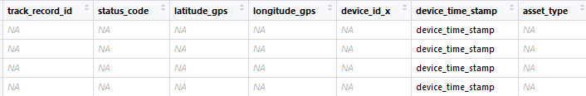
Understanding Of Data
Total Observations :-
Missing Data:- 4 Observations without any track record id so we can remove this.

Slide 3
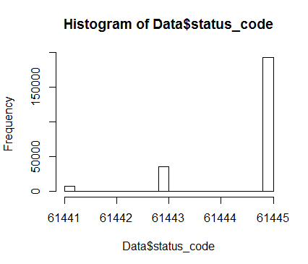

Frequency distribution of Status code (original code)
Frequency of status code after labelling as good log and bad log as given in instructions:-

Slide 4
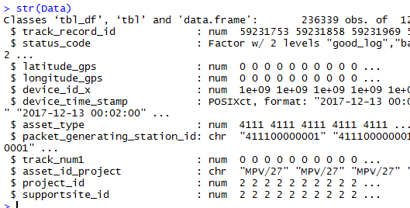
Structure of Data after Changing Date-Time Format of Data

Slide 5

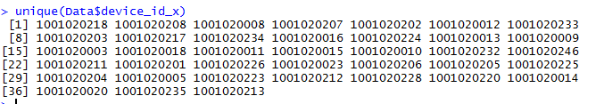
38 Device Id (Equipment Identifier)used by team x
Time difference of 4.999306 days when log was created

Slide 6
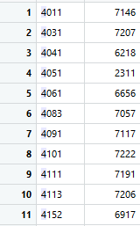

Movable Equipments Type-1:- 11
Movable Equipments Type-2:- 4
Stationary Equipments Type-1:- 1
Stationary Equipments Type-2:- 1
Asset_type Freq.
Asset_type Freq.
Asset_type Freq.

Slide 7


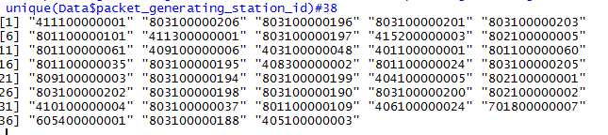
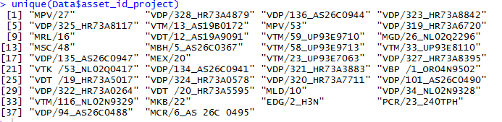
Count of Track number:- Ignition On(1)
Project Id(Where the equipment is working):-2
Support site Id:-2,3
Packet generating station ID:- 38
Asset ID Project(used by team y):-38

Slide 8
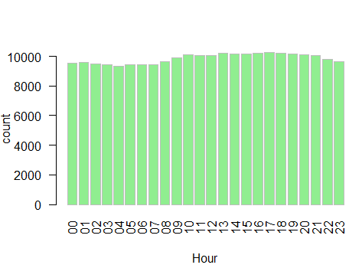
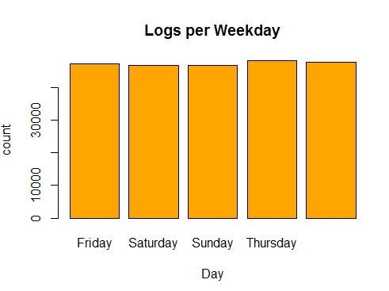

Geospatial Logs from Different Equipments Per Day/Hour

Slide 9
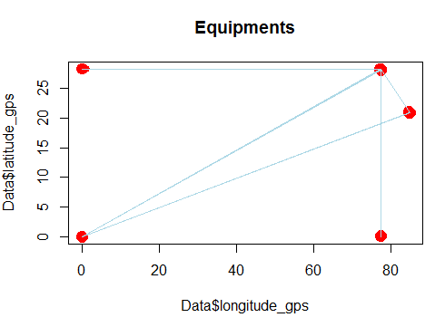
Plot Of Longitude and Latitude of data
The point at which the equator (0° latitude) and the prime meridian (0° longitude) intersect has no real significance.

Slide 10
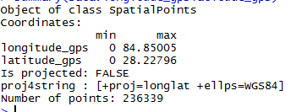
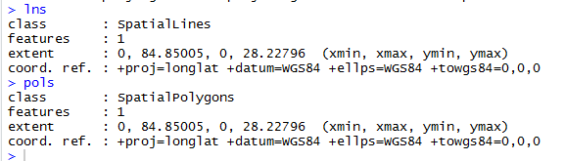
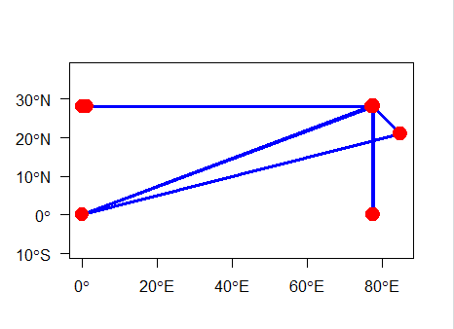
Converting Data into Spatial Data Frame

Slide 11
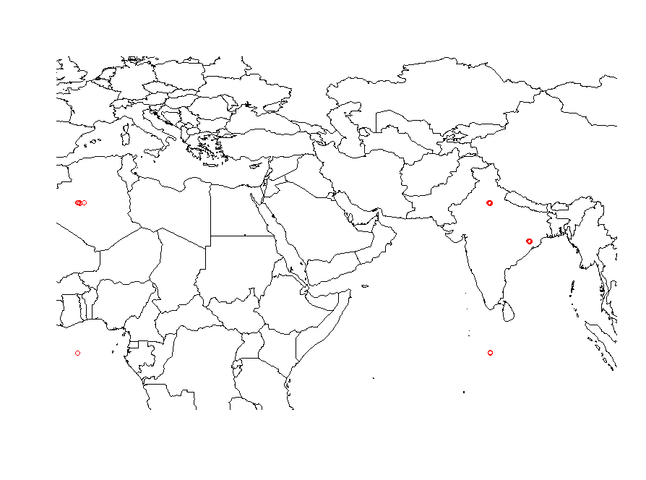
Position on map

Slide 12
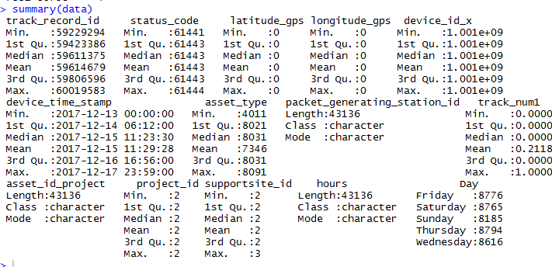
Summary of data ,subset of (0,0) showing bad logs

Slide 13
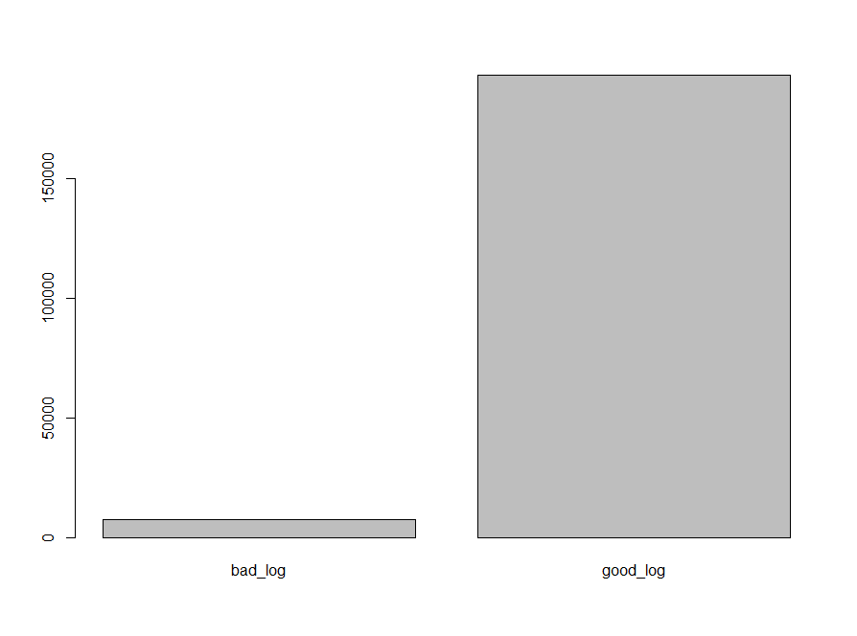

Slide 14
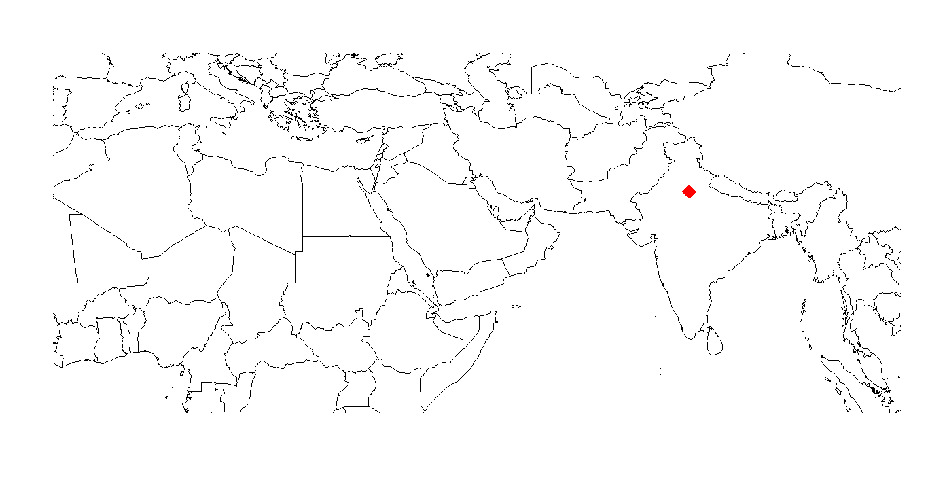
Main Equipment

Slide 15
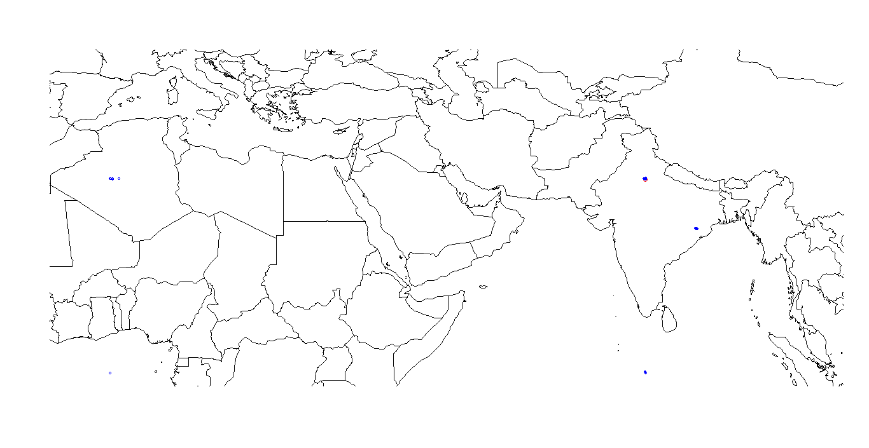
Main Equipment with other

Slide 16
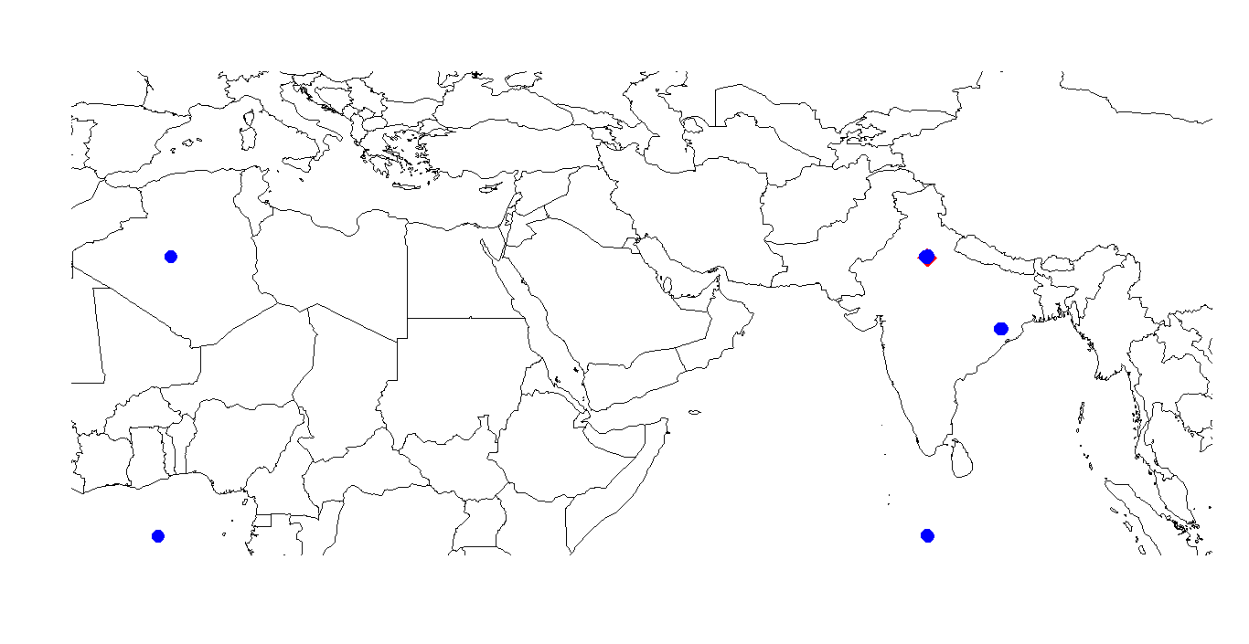
Position of Equipments along with Main Equipment on Wednesday

Slide 17
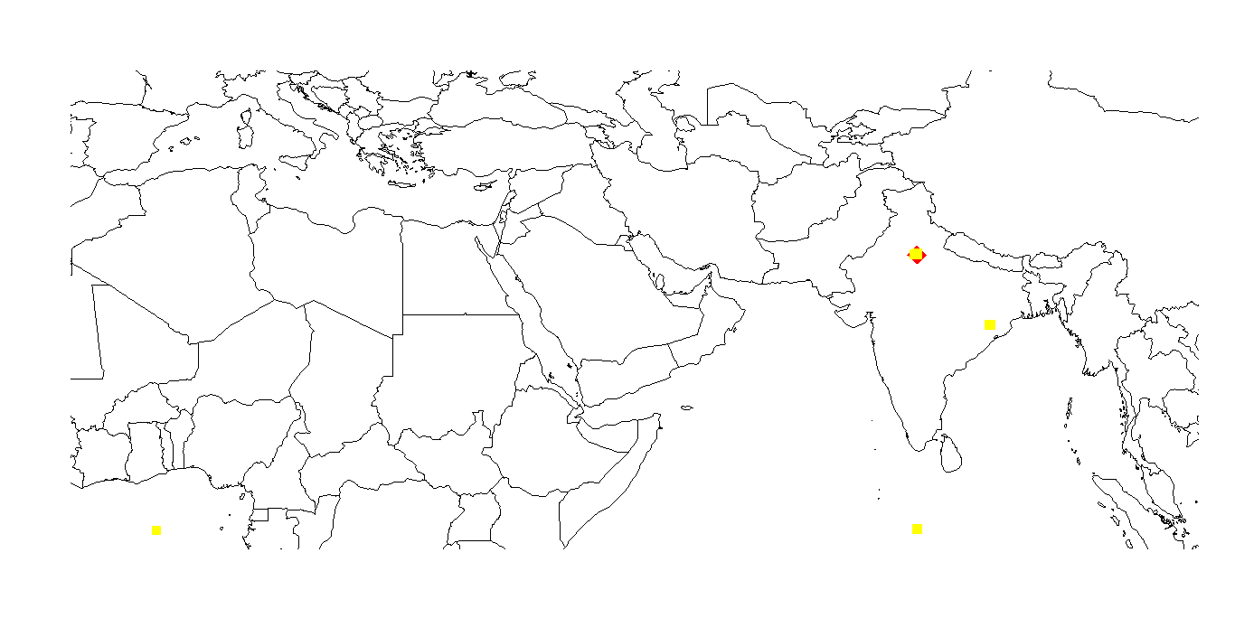
Position of Equipments along with Main Equipment on Thursday

Slide 18
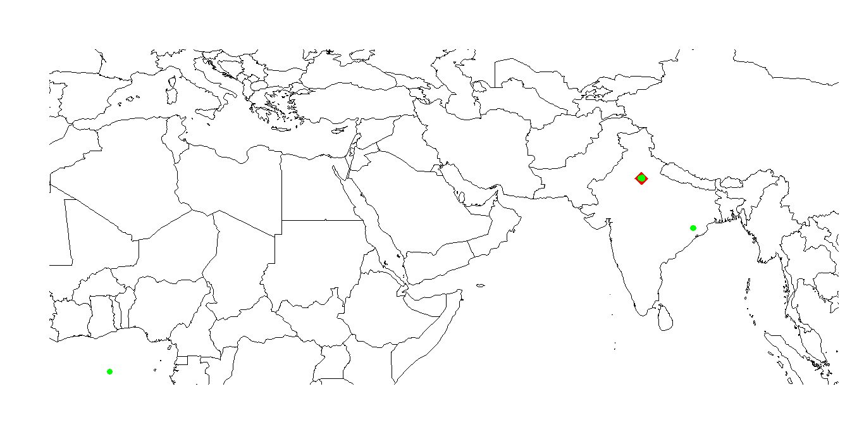
Friday

Slide 19
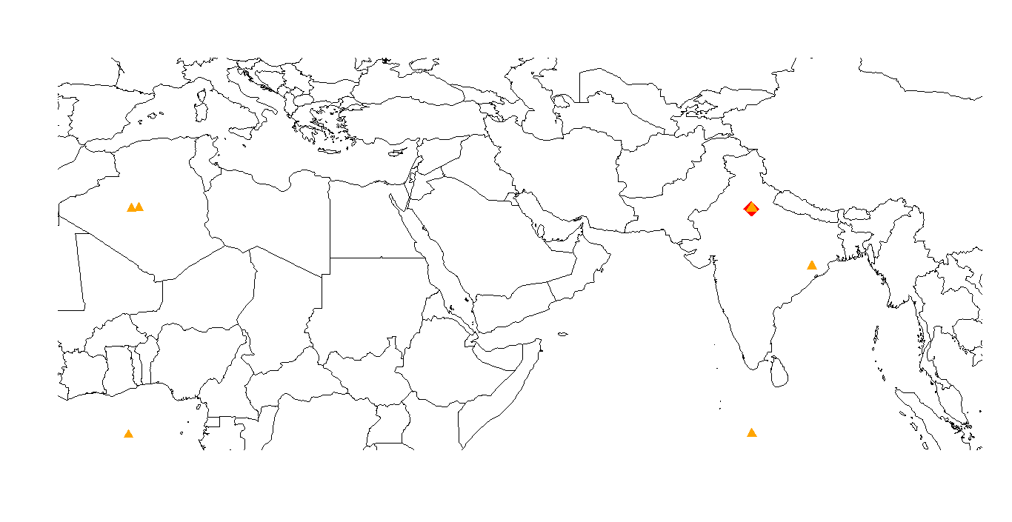
Saturday

Slide 20

Sunday

Slide 21
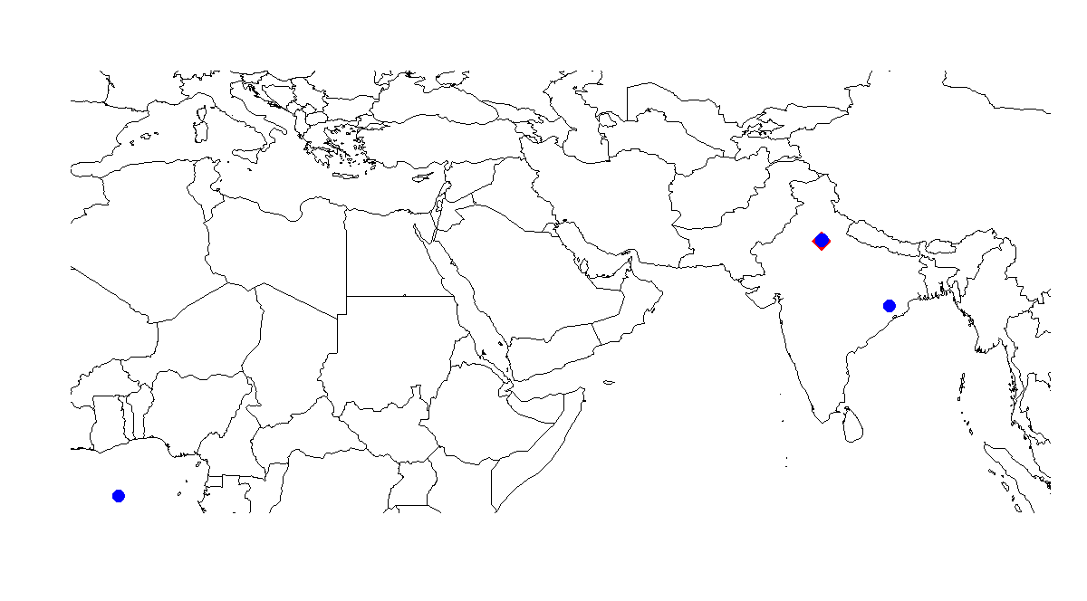
Between 9:00 am-9:10am-wednesday

Slide 22
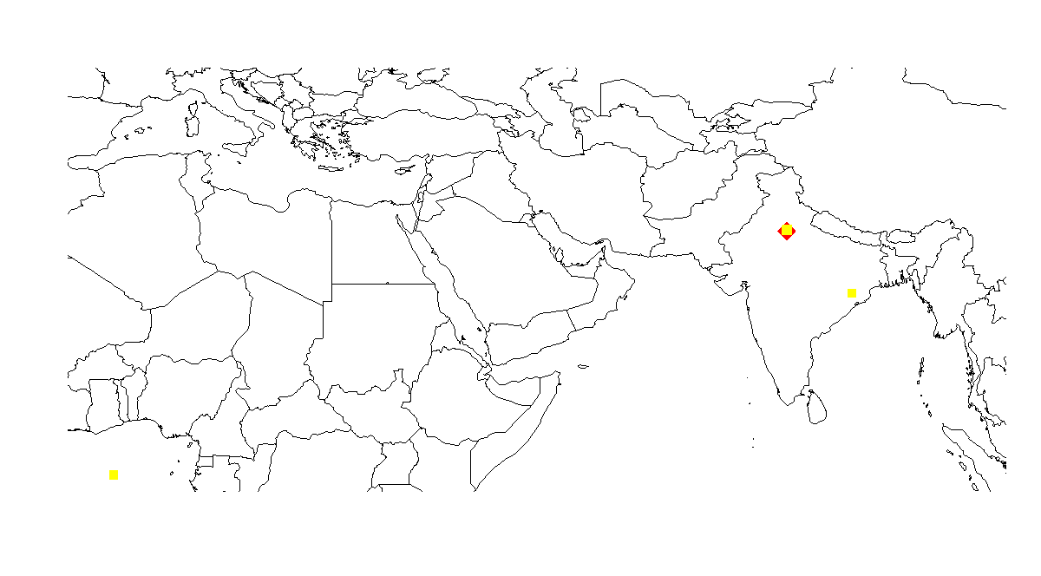
Thursday

Slide 23
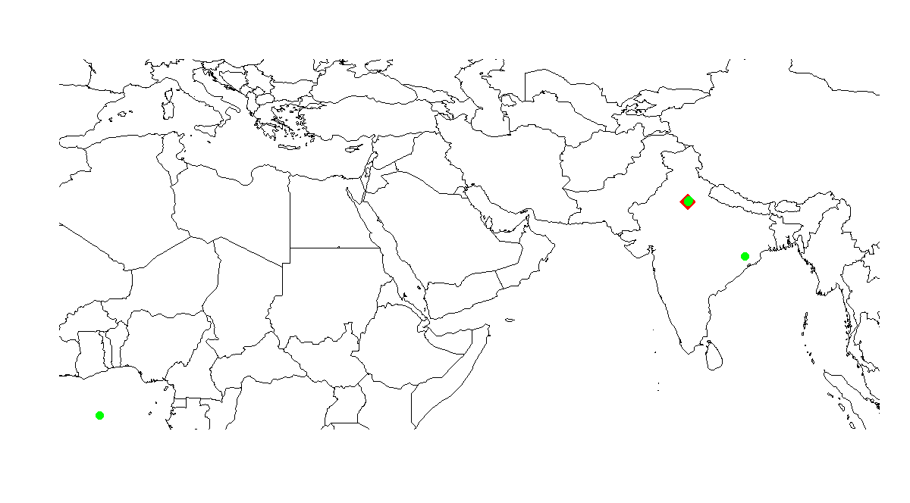
Friday

Slide 24
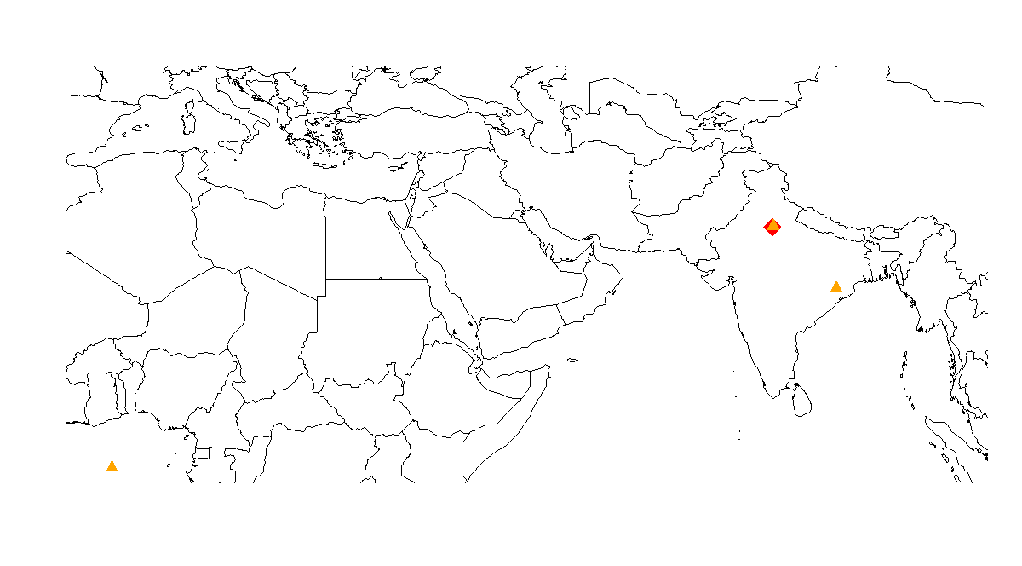
Saturday

Slide 25
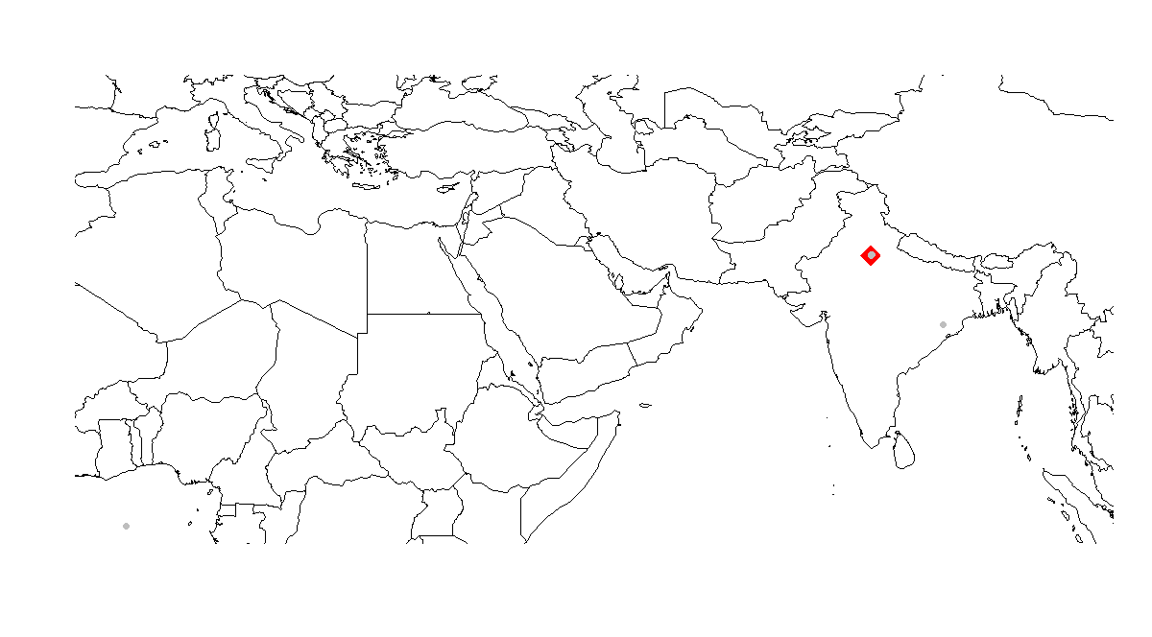
Sunday

